Slide 1
From Students to Learners: New Learning Environments for 21st Century Learners
Bob Pearlman bobpearlman@mindspring.com http://www.bobpearlman.org
Association for Learning Environments (A4LE) NW
Anchorage, Alaska
June 24, 2016
PowerPoint Slides and Resources at http://www.bobpearlman.org/a4le.htm

Slide 2
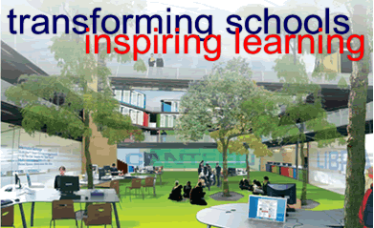
The Architect’s and Facility Planner’s Dilemma
You work with client school or school district leaders and the task force to envision the new school building.
The task force goes through an exciting visioning process and opts for a building that they believe enables and supports 21st century learning.
The building is built. The teachers move in and say, “What the ……… is this?” They have no idea how to utilize the new learning environments.
This has happened all over the USA and especially in England during the Building Schools of the Future initiative 2003-2010.
London Challenge Visualization, November 2004
England’s Building Schools of the Future, 2003-2010
But what if the teachers were prepared to design student learning experiences utilizing the new environments?
“old wine in new bottles”

Slide 3
So what does 21st Century Learning Look Like? And how do you get there?
21st
Century
Skills
Pedagogy
and
Practice
How kids
work
in school
New
Learning
Environments
Linking Pedagogy and Space

Slide 4
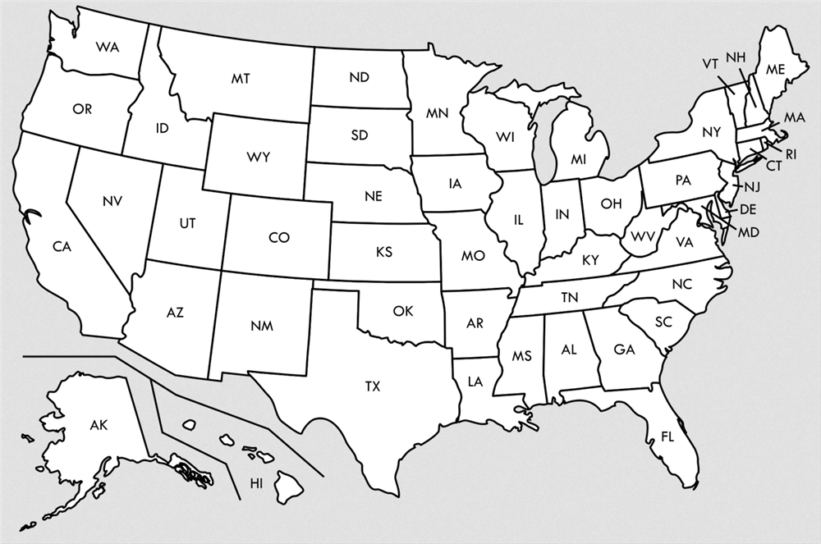
My Journey to Anchorage, June 7-22, 2016
JFK
Charlottesville
June 7
Greenville
Atlanta
Tucson
Austin
Anchorage

Slide 5
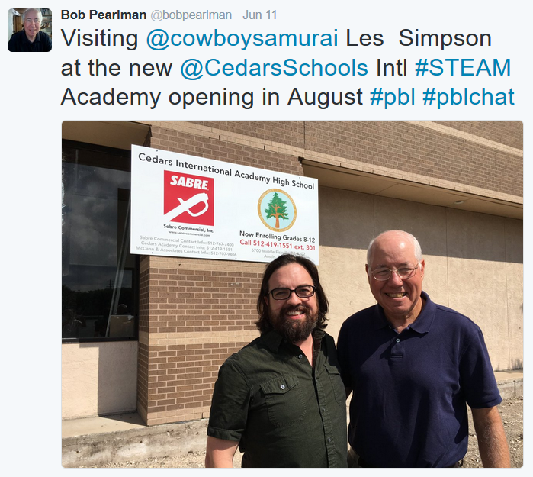
Austin, June 11

Slide 6
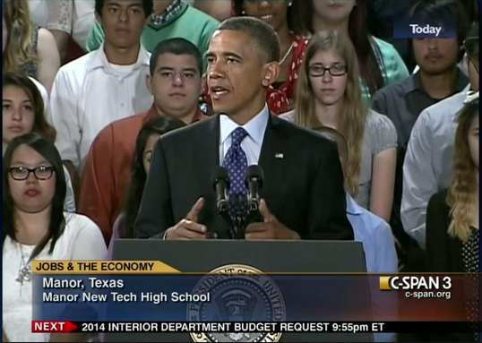
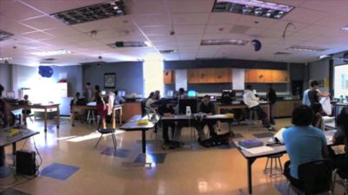
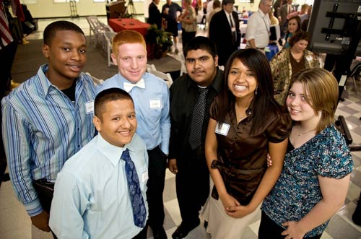
Manor, TX (Near Austin, TX), opened 2007
Steve Zipkes, is Founding Former Principal, Manor New Technology High School, Distinguished Educator, and Founding Current Principal, New Cedars Academy, A Next Generation STEAM HS.

Slide 7
Watching the School Videos: Make 2 Lists
Principles, Pedagogies, Practices
List #1: Key elements of this teaching and learning practice.
1. __________________________________________________
2. __________________________________________________
3. __________________________________________________
4. __________________________________________________
5. __________________________________________________
6. __________________________________________________
7. __________________________________________________
Spaces
List #2: Key elements of the learning environments
1. __________________________________________________
2. __________________________________________________
3. __________________________________________________
4. __________________________________________________
5. __________________________________________________
6. __________________________________________________
7. __________________________________________________

Slide 8
Click on picture or here to play on youtube

Slide 9
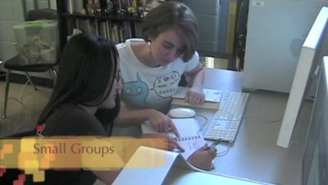
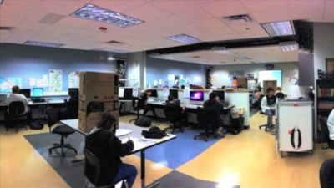
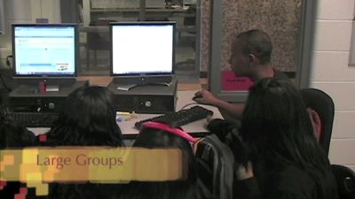
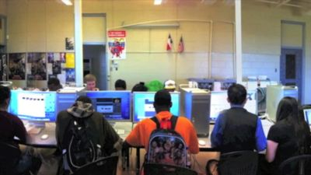
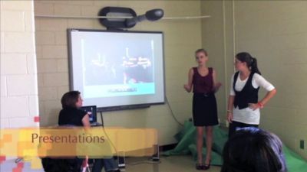

Slide 10
Principles, Pedagogies, Practices
List #1: Key elements of this teaching and learning practice.
Project-Based Learning
Individual workspaces
Small group workspaces
Large group workspaces
Presentation spaces
Spaces
List #2: Key elements of the learning environments
Spacious, double-size classrooms for double group of students and two teachers integrating two subject areas

Slide 11
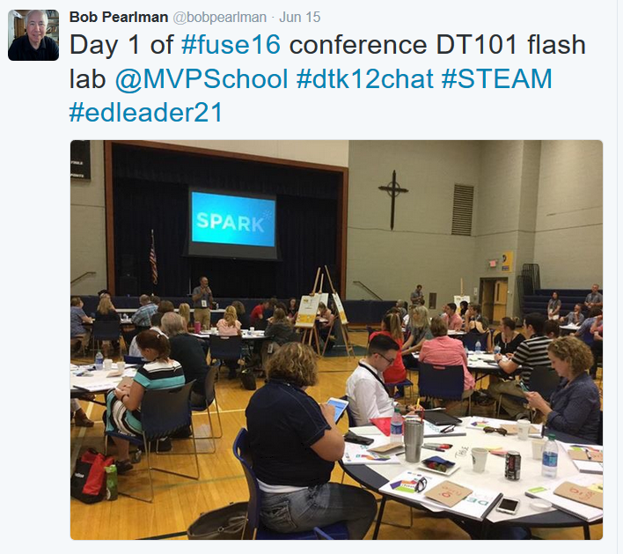
Atlanta, June 15

Slide 12
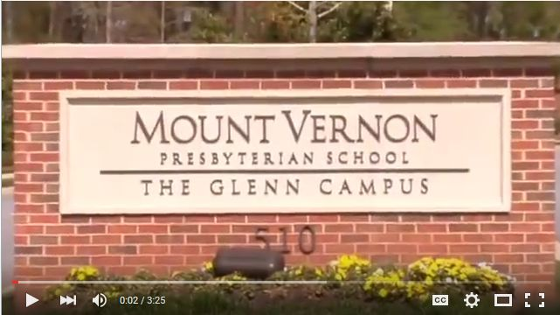
http://www.mvifi.org/fuse16/
Twitter: #fuse16

Slide 13
i.Design Lab
Click on picture or here to play on youtube

Slide 14
Principles, Pedagogies, Practices
List #1: Key elements of this teaching and learning practice.
Design Thinking / Stanford .d School
DEEP: Discover / Empathy /Experiment / Produce
College / Career /Citizenship / Calling
21st century learners
Technology use / hands-on learning
Critical Thinking / Creativity / Collaboration / Problem Solving / Effective Communicator / Civically Engaged – The 4Cs+
Spaces
List #2: Key elements of the learning environments
i.Design Lab
Maker spaces and equipment ubiquitous
Outdoor garden learning environment

Slide 15
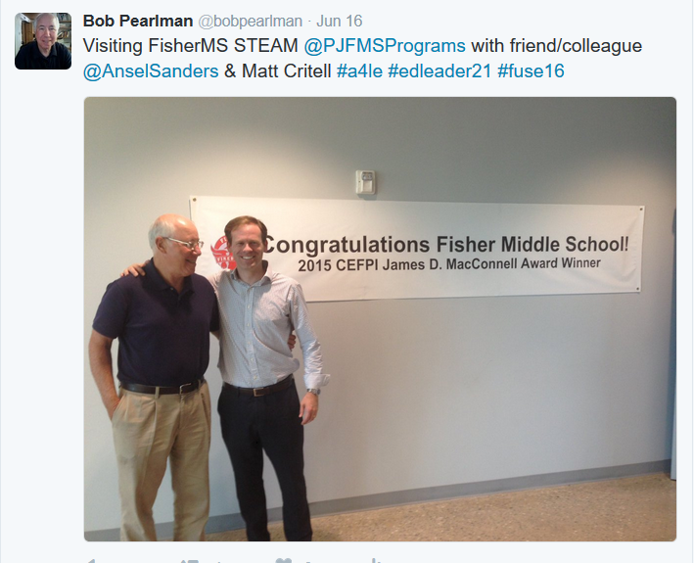
Greenville, June 16

Slide 16
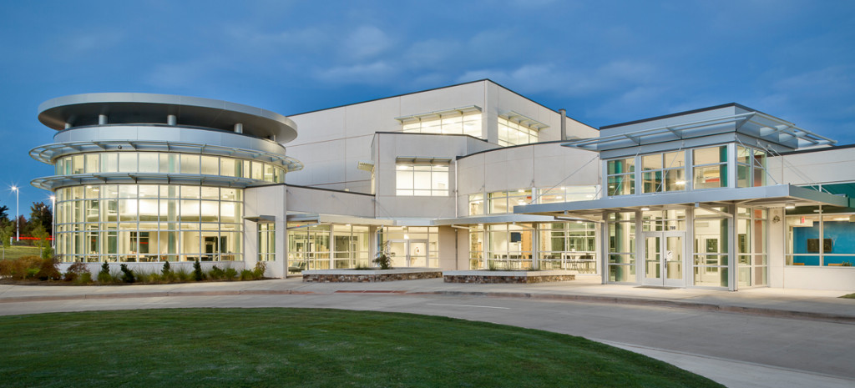
The 2015 CEFPI MacConnell Award Winner, Fisher STEAM Middle School, co-designed by Fielding Nair International and McMillan Pazdan Smith, features six learning communities of about 125 students, with eight different instructional spaces for each learning community.

Slide 17
Greenville County (SC) Schools' Dr. Phinnize J. Fisher Middle School, a PBL STEAM middle school, is named the CEFPI 2015 James D. MacConnell Award Winner. See submittal. Also see the New Learning Environments section of the bobpearlman.org website.
Click on picture or here to play on youtube

Slide 18
Principles, Pedagogies, Practices
List #1: Key elements of this teaching and learning practice.
STEAM
Project-Based Learning
“Involve me and I learn” – Ben Franklin
Hands-on Learning
Environments that make it easier to work on projects
Building as Teaching Tool
Spaces
List #2: Key elements of the learning environments
Learning Communities
Breakout spaces
Large Classrooms
Outdoor Courtyard learning space
Common Areas
Collaboration Rooms for students
Teacher Collaboration Rooms
Natural light / Glass enclosed server rooms / exposed HVAC
Lobby Area sunken amphitheater

Slide 19
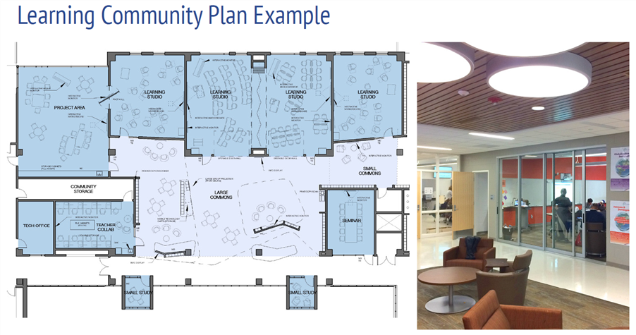

Slide 20
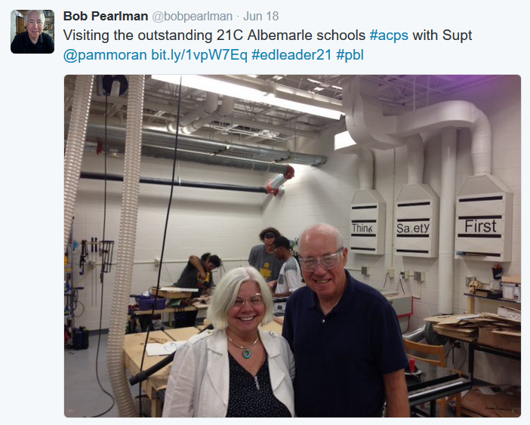
Charlottesville, June 18

Slide 21
Click on picture or here to play on youtube

Slide 22
Principles, Pedagogies, Practices
List #1: Key elements of this teaching and learning practice.
Student Engagement
Collaborative Work
Spaces for individual work, small group work, large group work
Seating where you work the best
Spaces
List #2: Key elements of the learning environments
Caves / Watering Holes
Multiple different kinds of seating and workspaces. Couches, soft chairs.
Tables, not individual work desks
Click for Web Profile of Albemarle County Public Schools, VA

Slide 23
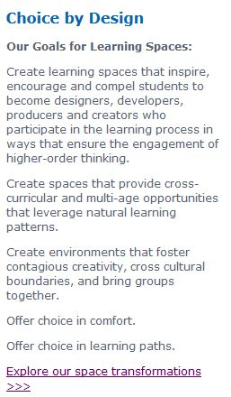
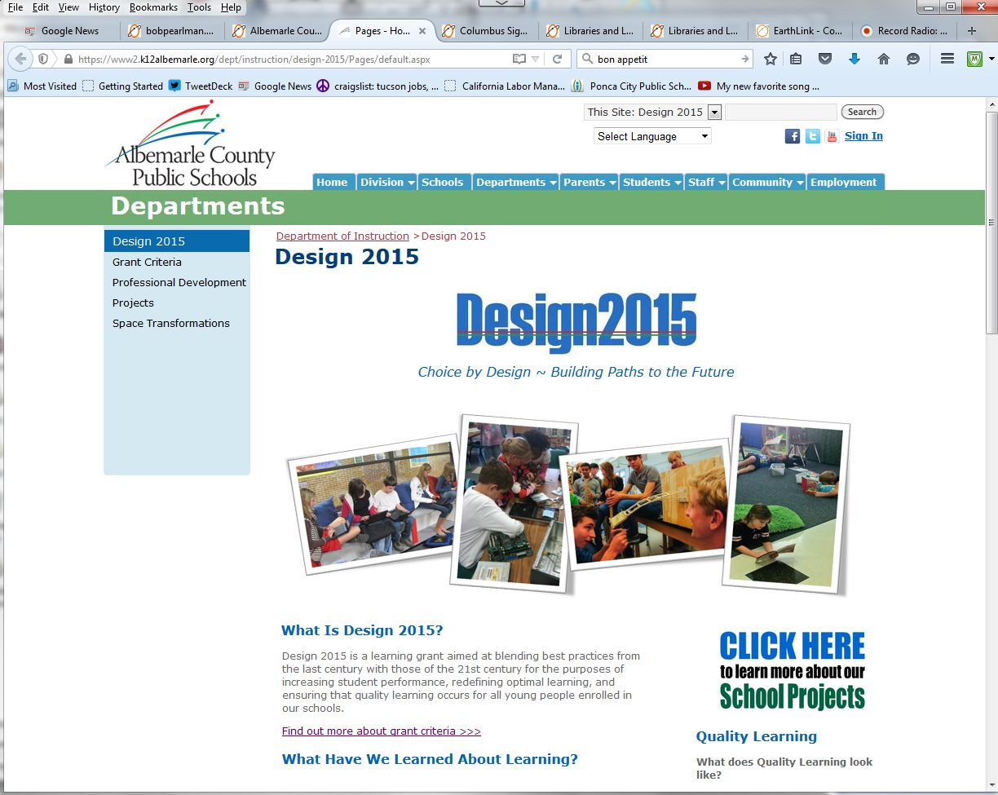
Albemarle’s Design 2015

Slide 24
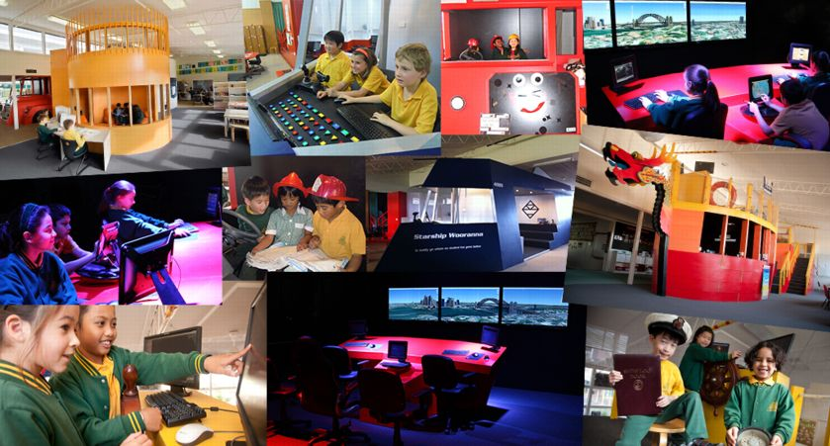
Wooranna Park Primary School, Melbourne, Australia

Slide 25
Wooranna Park Primary School, Melbourne, Australia
Click on picture or here to play on youtube

Slide 26
Wooranna Park Primary School, Melbourne, Australia
“In planning a learning environment our first step must always be to outline our pedagogical needs”
Principles, Pedagogies, Practices
List #1: Key elements of this teaching and learning practice.
Play, explore
Develop understanding of their world through Dance / Music / Artistic Expression / Researching scientific or mathematical theory
Projects
Students and teachers collaborating as co-learners through Targeted Teaching Groups / Learning Agreement Time /Exploration of Passion Areas
Imagination / Creativity / Experiential /Interdisciplinary
Spaces
List #2: Key elements of the learning environments
Mobile lecture style amphitheater seating
Tables
Reading areas
Stimulating Learning Platforms: Bus / Dragon Boat / Spaceship / Enigma Portal
Student-Teacher conferencing spaces / Small Group spaces /Studio Lab /Quiet Study Room /Workshop Room

Slide 27
Wooranna Park Primary School, Melbourne, Australia
Stimulating Learning Platforms

Slide 28
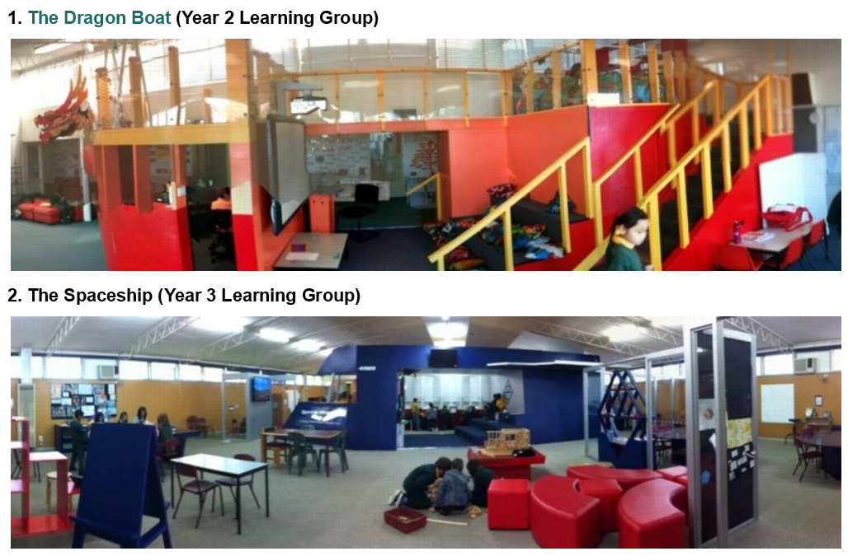

Slide 29
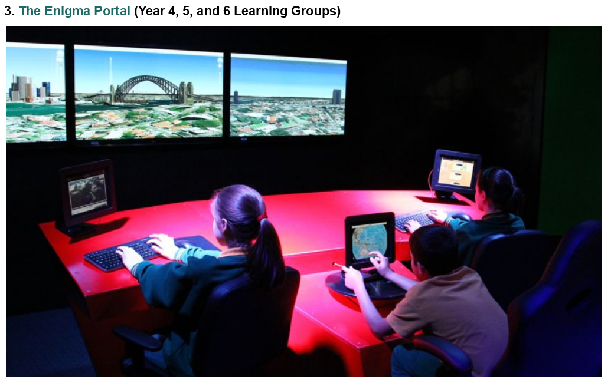

Slide 30
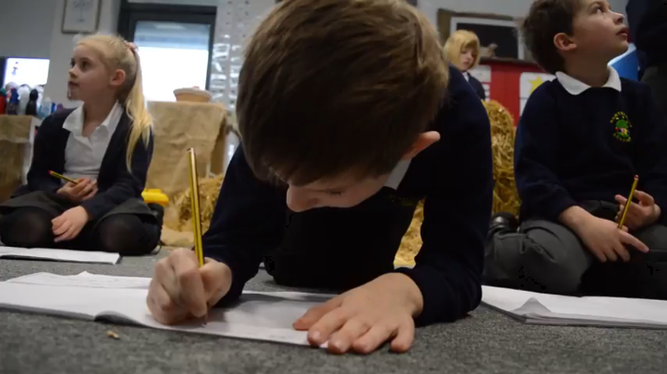
Lincoln (Midlands), England
Click on picture or here to play on youtube

Slide 31
Principles, Pedagogies, Practices
List #1: Key elements of this teaching and learning practice.
Respect
Empower
Believe
Learn
Succeed
Immersion Learning
New theme each term around a driving question (3 terms/year)
Spaces
List #2: Key elements of the learning environments
Farm, Market (No tables or chairs)
Classrooms transformed around theme of what children are being taught
Heart of School space

Slide 32
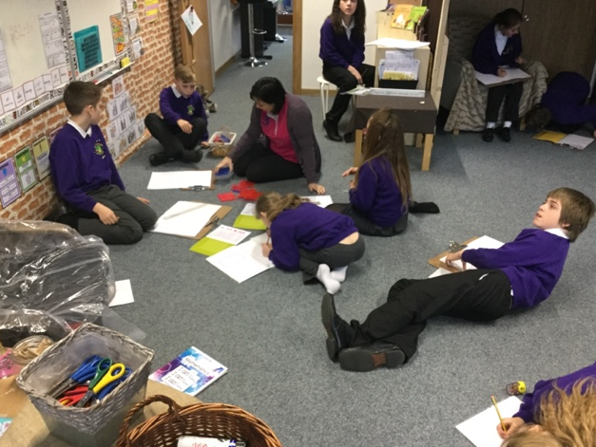
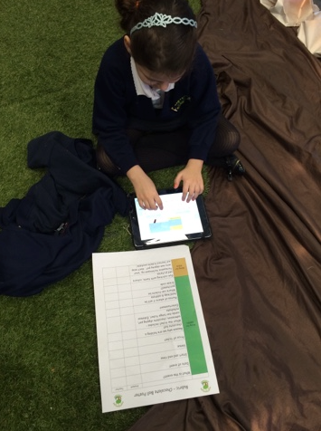
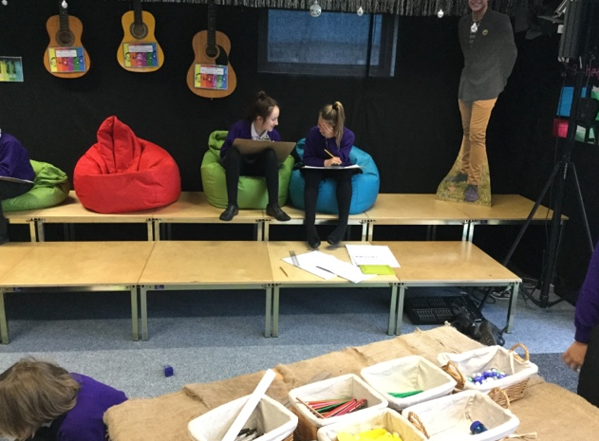

Slide 33
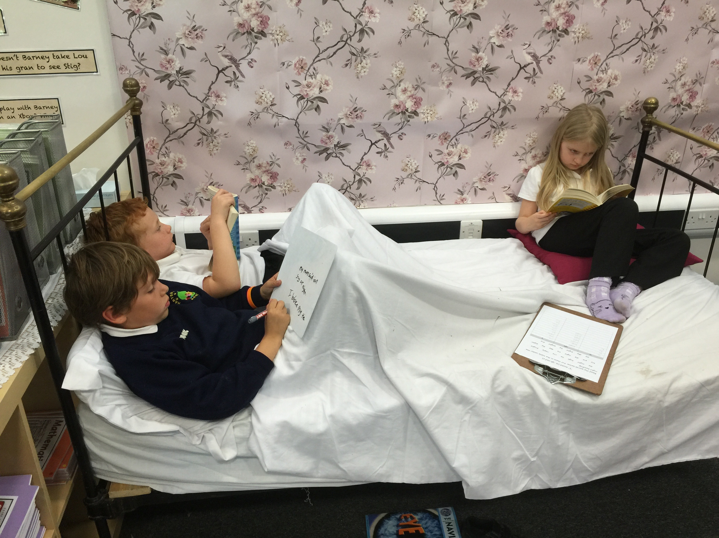

Slide 34
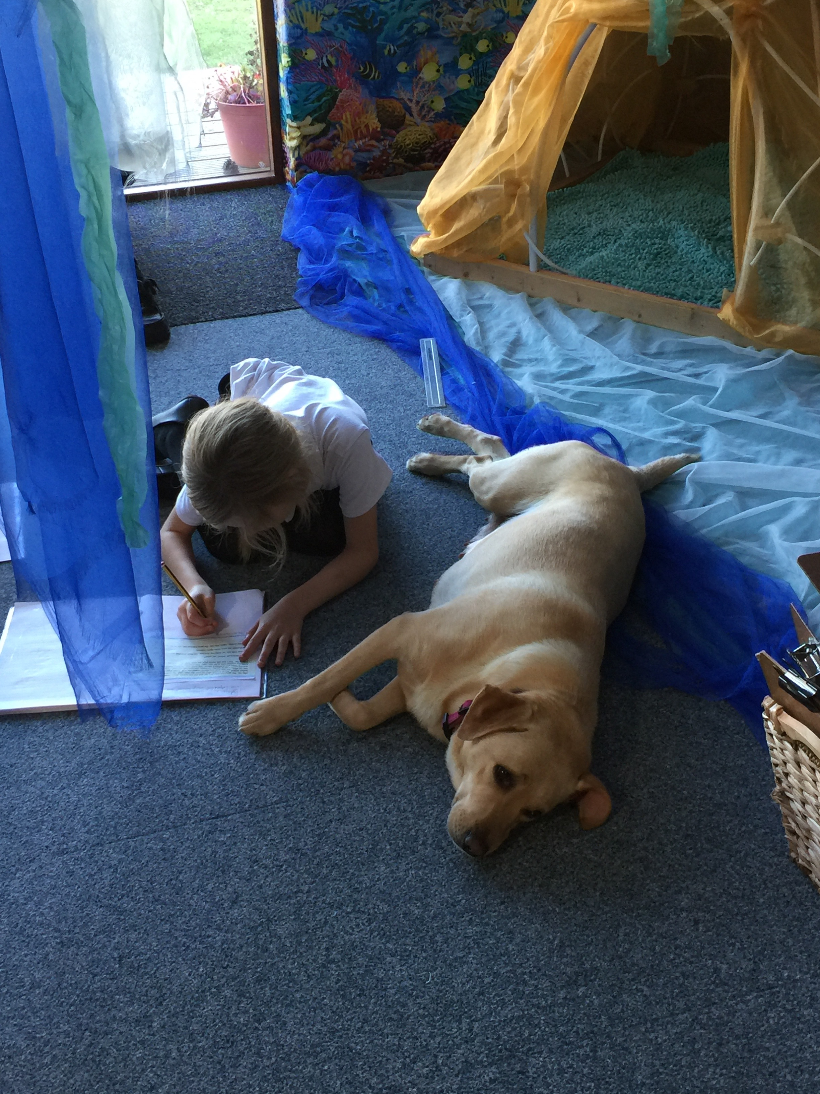

Slide 35
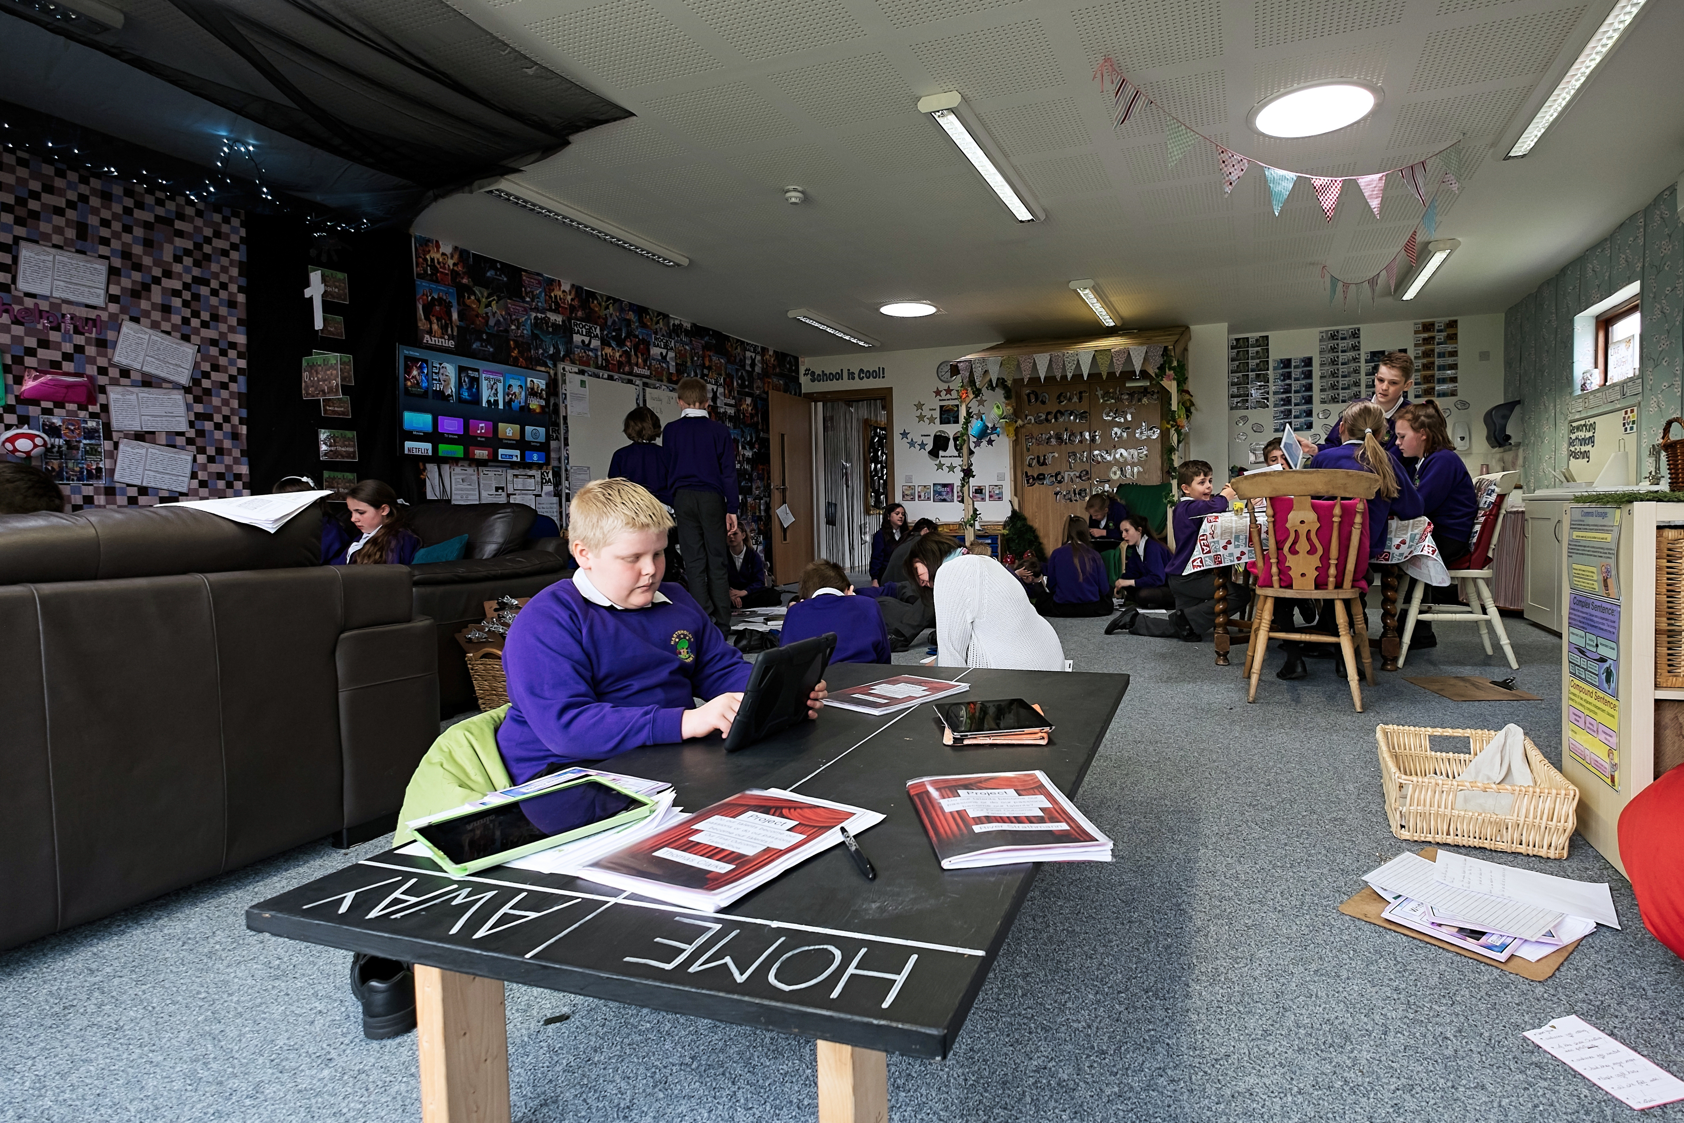

Slide 36
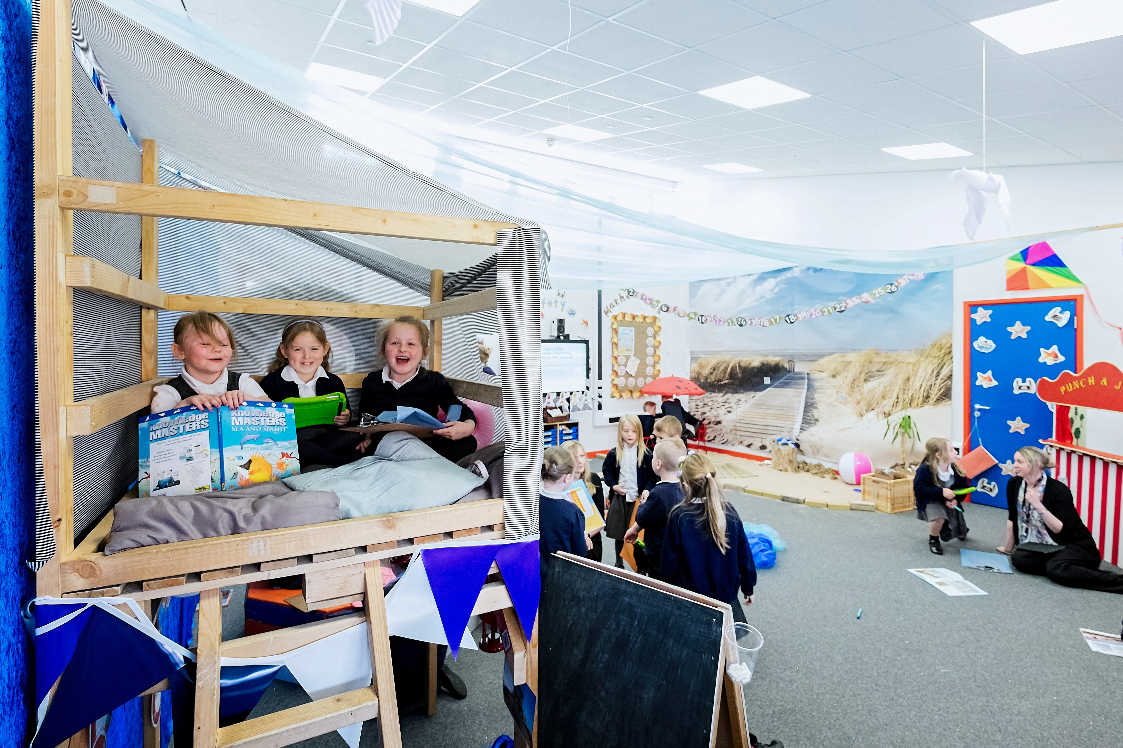

Slide 37
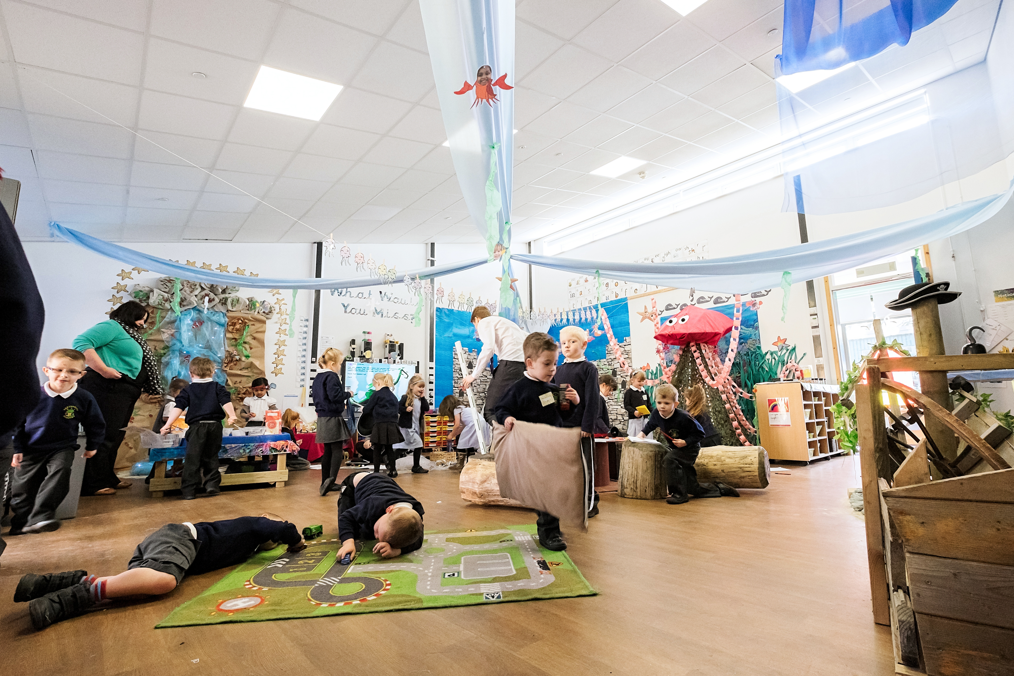

Slide 38
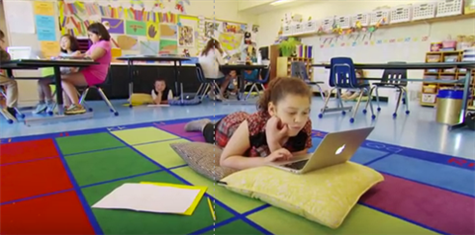
21st Century Learning: Schools as Workplaces for 21st Century Learners

Slide 39
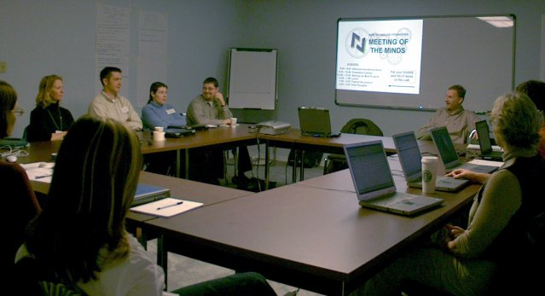
Putting It All Together
PBL curriculum and pedagogy
Assessment for learning
Technology
Learning spaces and environment
Professional development
Education Readiness: Are the teachers prepared to design student learning experiences utilizing the new environments?

Slide 40
Contact Information
Bob Pearlman 21st Century School and District Consultant bobpearlman@mindspring.com www.bobpearlman.org (520) 881-9965
PowerPoint Slides and Resources at http://www.bobpearlman.org/a4le.htm

