Slide 1
From Students to Learners: New Learning Environments for 21st Century Learners
Workshop
Bob Pearlman bobpearlman@mindspring.com http://www.bobpearlman.org
Association for Learning Environments (A4LE) NW
Anchorage, Alaska
June 24, 2016
PowerPoint Slides and Resources at http://www.bobpearlman.org/a4le.htm

Slide 2
Agenda
Q & A
Linking Principles/Pedagogy/Practices to Space
Break
Designing the new HS/MS/ES/K-8/6-12 school for 21st Century Learning

Slide 3
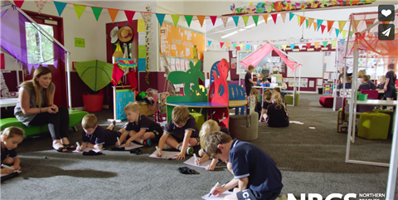
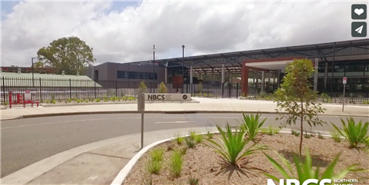
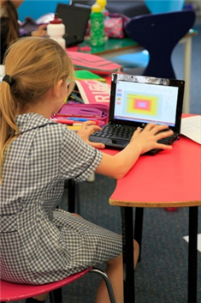
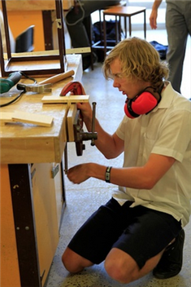
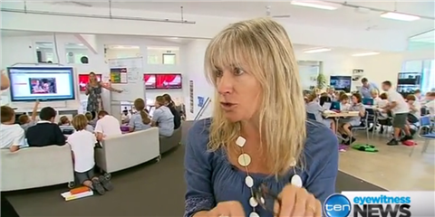

Slide 4
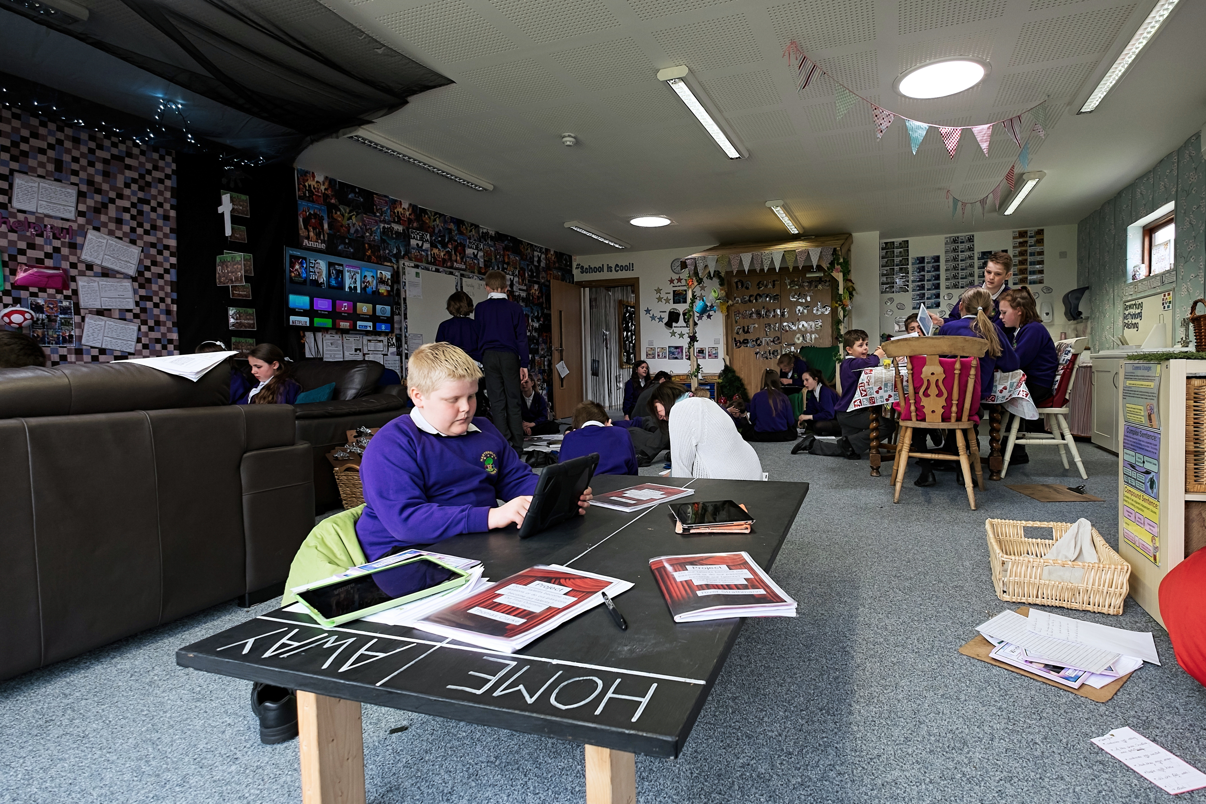
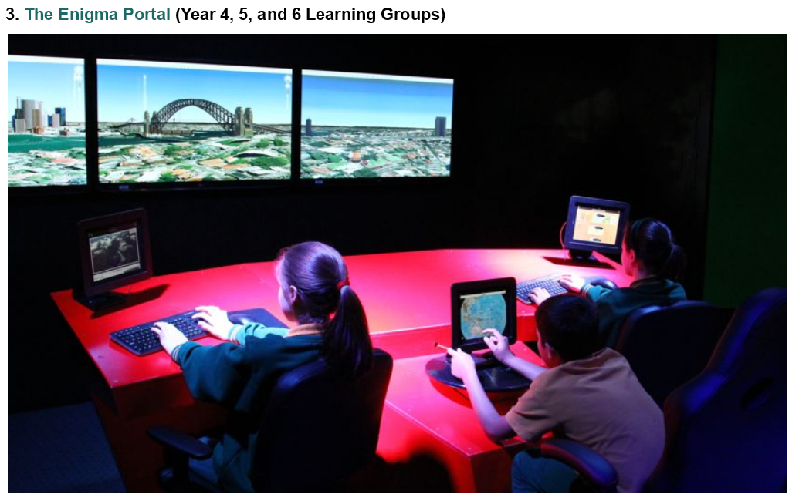
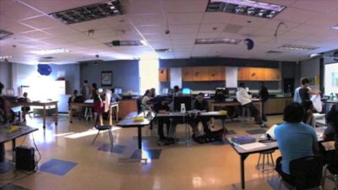
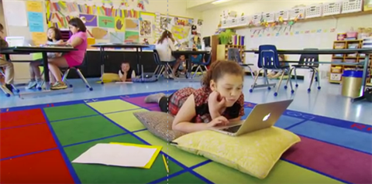
21st Century Learning: Schools as Workplaces for 21st Century Learners

Slide 5
So what does 21st Century Learning Look Like? And how do you get there?
21st
Century
Skills
Pedagogy
and
Practice
How kids
work
in school
New
Learning
Environments
Linking Pedagogy and Space

Slide 6
Watching the School Videos: Make 2 Lists
Principles, Pedagogies, Practices
List #1: Key elements of this teaching and learning practice.
1. __________________________________________________
2. __________________________________________________
3. __________________________________________________
4. __________________________________________________
5. __________________________________________________
6. __________________________________________________
7. __________________________________________________
Spaces
List #2: Key elements of the learning environments
1. __________________________________________________
2. __________________________________________________
3. __________________________________________________
4. __________________________________________________
5. __________________________________________________
6. __________________________________________________
7. __________________________________________________

Slide 7
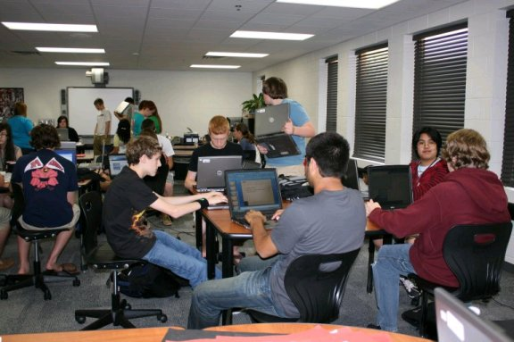
New Tech High @ Coppell, Coppell, TX, opened 2008
Figure 4. Student project teams at work in double-sized classroom at New Tech High @ Coppell, Coppell, TX. Photo by Kate Jenkins
Notes:
7

Slide 8
New Tech High @ Coppell, Coppell, TX
Extended Learning Spaces
Click on picture or here to play on youtube

Slide 9
Watching the School Videos: Make 2 Lists
Principles, Pedagogies, Practices
List #1: Key elements of this teaching and learning practice.
1. __________________________________________________
2. __________________________________________________
3. __________________________________________________
4. __________________________________________________
5. __________________________________________________
6. __________________________________________________
7. __________________________________________________
Spaces
List #2: Key elements of the learning environments
1. __________________________________________________
2. __________________________________________________
3. __________________________________________________
4. __________________________________________________
5. __________________________________________________
6. __________________________________________________
7. __________________________________________________

Slide 10
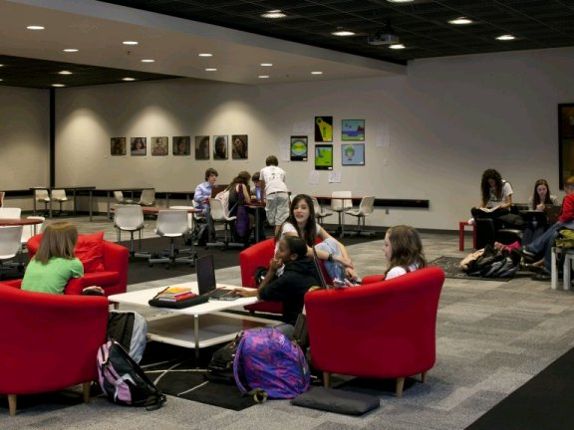
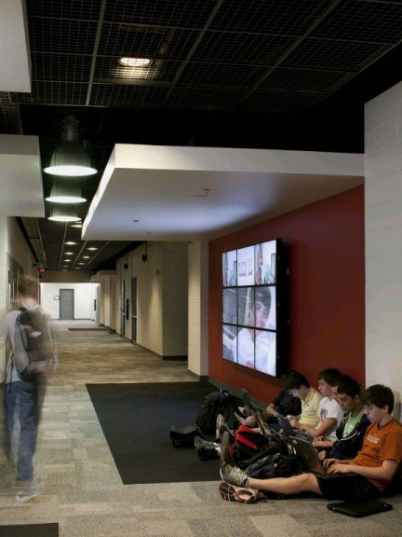
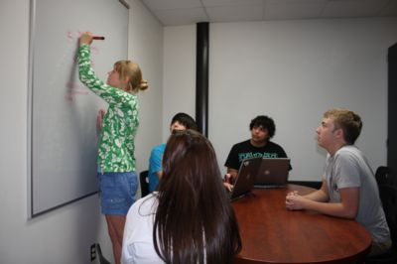
Student collaborative project teams working in the digital media library, in the corridor, and a project planning room, some of the many extended learning spaces at New Tech High, Coppell, Coppell, TX. Photos by SHW Group, Plano, TX, and Kate Jenkins

Slide 11
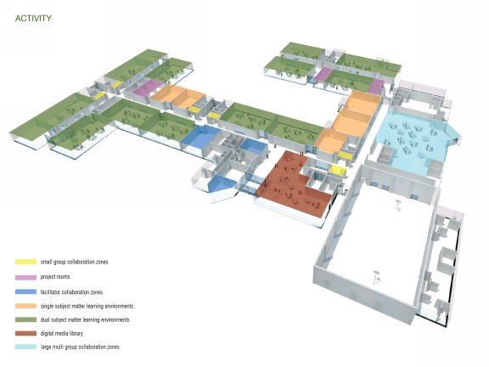

Slide 12
 | New Tech High, @ Coppell
Primary student work area | Dual subject matter learning environment
Presentation space | Large multi-group collaboration zones
Large group space | Large multi-group collaboration zones
Extended learning spaces | Corridor alcoves Project planning rooms Media library Outdoor benches
Specialty labs | Science lab
Furniture | Mix and match tables, office chairs, lounge chairs, and sofas in extended learning spaces

Slide 13
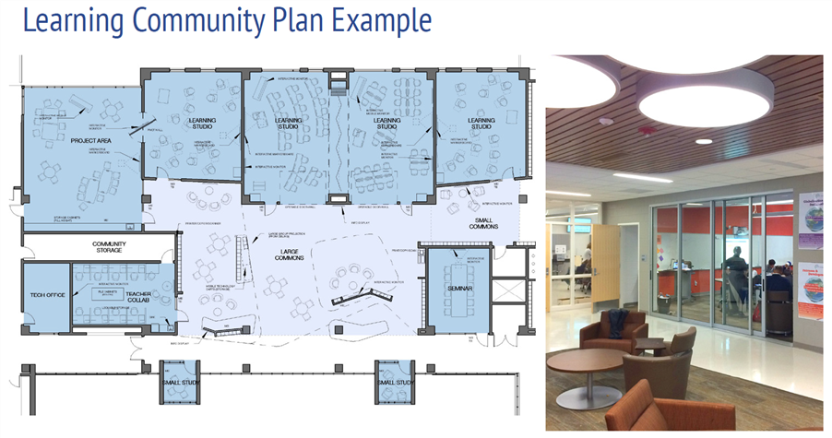

Slide 14
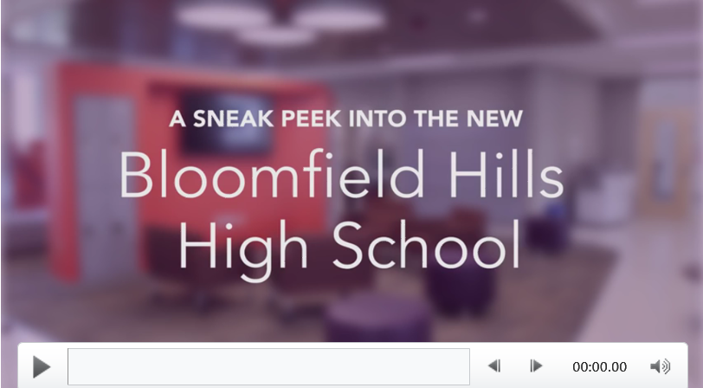
Click on picture or here to play on youtube

Slide 15
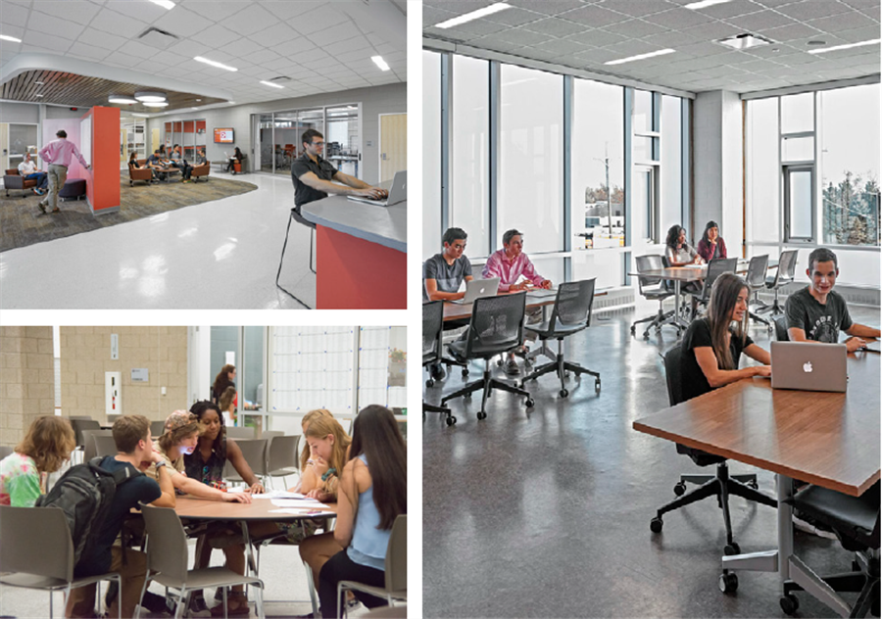

Slide 16
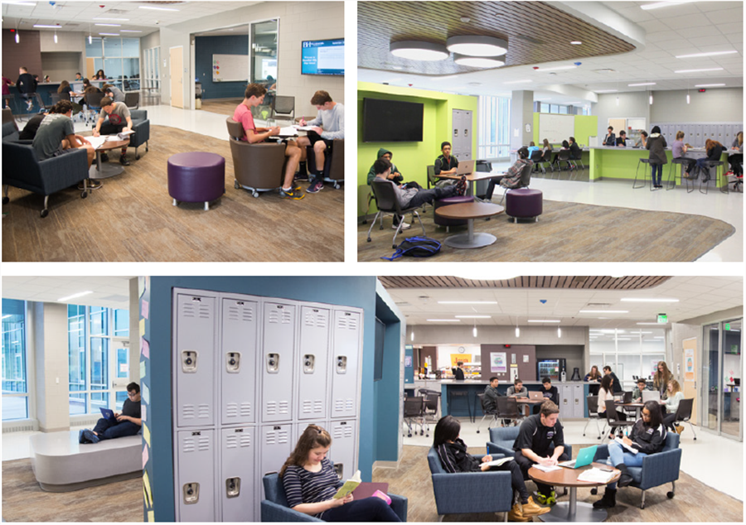

Slide 17
Watching the School Videos: Make 2 Lists
Principles, Pedagogies, Practices
List #1: Key elements of this teaching and learning practice.
1. __________________________________________________
2. __________________________________________________
3. __________________________________________________
4. __________________________________________________
5. __________________________________________________
6. __________________________________________________
7. __________________________________________________
Spaces
List #2: Key elements of the learning environments
1. __________________________________________________
2. __________________________________________________
3. __________________________________________________
4. __________________________________________________
5. __________________________________________________
6. __________________________________________________
7. __________________________________________________

Slide 18
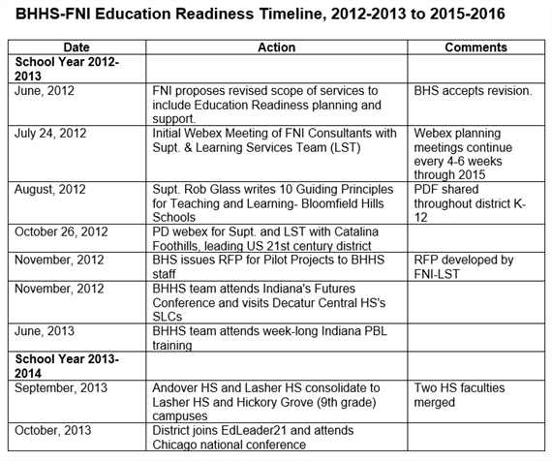

Slide 19
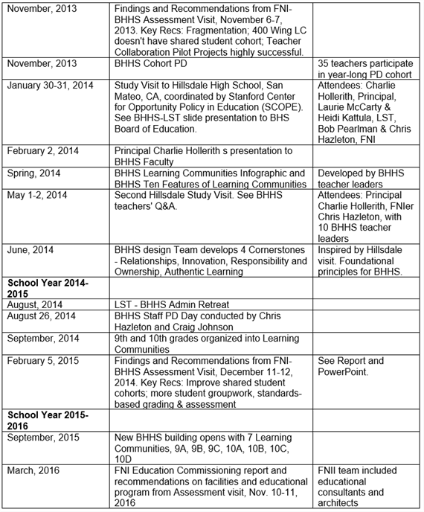

Slide 20
Norma Rose Point School, 2014 (Vancouver, BC)
Click on picture or here to play on youtube

Slide 21
Watching the School Videos: Make 2 Lists
Principles, Pedagogies, Practices
List #1: Key elements of this teaching and learning practice.
1. __________________________________________________
2. __________________________________________________
3. __________________________________________________
4. __________________________________________________
5. __________________________________________________
6. __________________________________________________
7. __________________________________________________
Spaces
List #2: Key elements of the learning environments
1. __________________________________________________
2. __________________________________________________
3. __________________________________________________
4. __________________________________________________
5. __________________________________________________
6. __________________________________________________
7. __________________________________________________

Slide 22
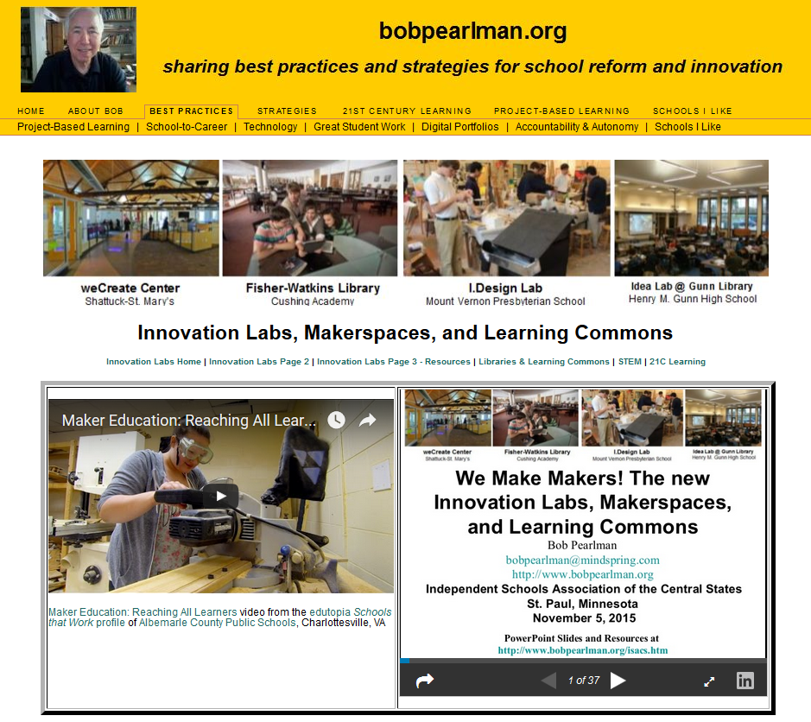
Innovation Labs & Makerspaces
http://www.bobpearlman.org/Learning21/innovation_labs.htm

Slide 23
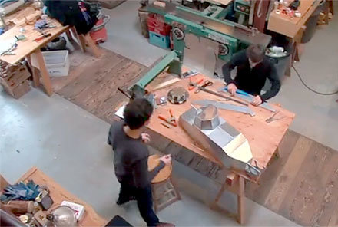
East Hampton, NY
Opened 2012
Click here to play on youtube;

Slide 24
Click on picture or here to play on Vimeo

Slide 25
Click on picture or here to play on youtube

Slide 26
You and your tablemates have been hired to work with the school task force of students, parents, teachers, the principal, and community members to envision and then design a replacement [HS/MS/ES/K-8/6-12] school building for 21st Century Learning. You will lead the school task force to:
Develop the educational specifications - principles, pedagogies, and practices – of the new building.
Sketch the key learning environments and spaces of the new building.
All designs must meet the district’s Goals for Learning Spaces:
Create learning spaces that inspire, encourage and compel students to become designers, developers, producers and creators who participate in the learning process in ways that ensure the engagement of higher-order thinking.
Create spaces that provide cross-curricular and multi-age opportunities that leverage natural learning patterns.
Create environments that foster contagious creativity, cross cultural boundaries, and bring groups together.
Offer choice in comfort.
Offer choice in learning paths.

Slide 27
Contact Information
Bob Pearlman 21st Century School and District Consultant bobpearlman@mindspring.com www.bobpearlman.org (520) 881-9965
PowerPoint Slides and Resources at http://www.bobpearlman.org/a4le.htm

